Slide 1
Cancer Type Classification using Gene Expression Data
Project Group 10
Manasa Gajulavarthy
Dongkyu Lee
Pallavi Cholkhane

Slide 2
Main Idea and methods used
The main idea is to classify the data into cancer types and find the most responsible genes for cancer types(Ta,T1,T2+).
Principle steps and methods used:
Data preprocessing by understanding the data.
Identify the best feature selection technique to remove redundant data.
Random forest classification technique(all data and reduced data).
Naïve Bayes classification technique(all data and reduced data).

Slide 3
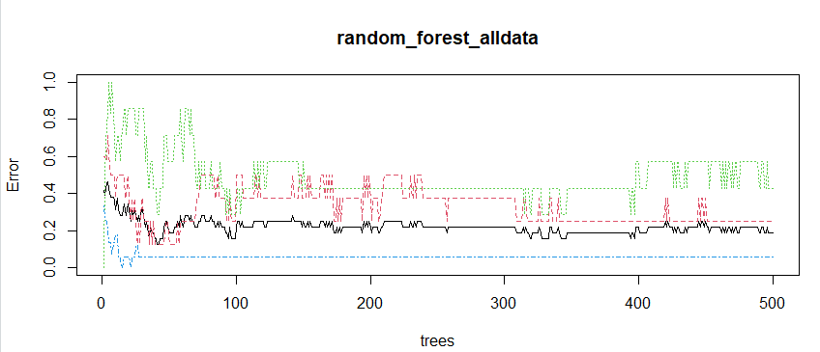
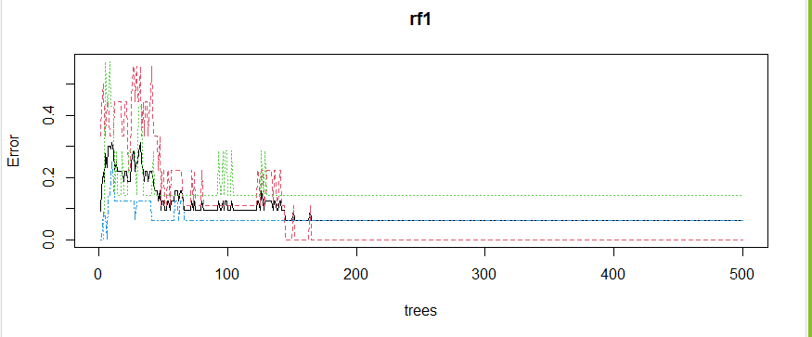
Challenges and Major Findings
Challenges:
Sample size is very less when compared to attribute space or the number of genes.
Computation time for running feature selection is really high.
Major Findings: Random forest plot on original data and reduced data.

Slide 4
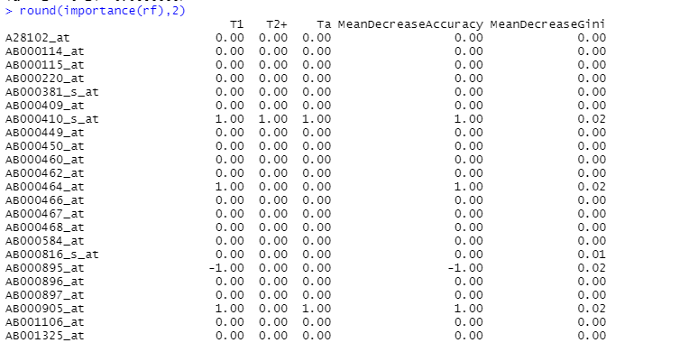
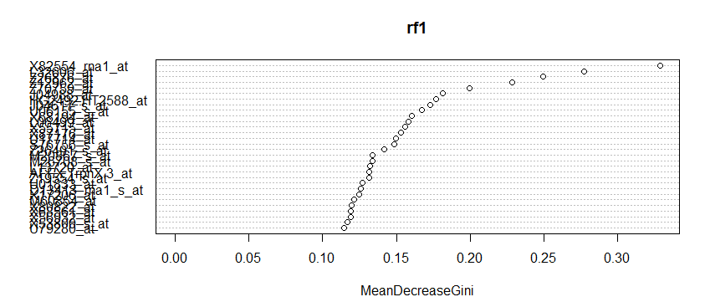
Major Findings
Table showing importance of genes with MeanDecreaseAccuracy and MeanDecreaseGini values:

Slide 5
Summary of the Major Findings
Removing redundant data :
- Using Correlation co-efficient (>0.75, reduced to 4284 genes)
- Using MeanDecreaseGini(>0, reduced to 1100 genes)
The table shows the average accuracy obtained with 10-fold cross validation in 3 cases:
 | Accuracy with original data | Accuracy with reduced data using MeanDecreaseGini | Accuracy with reduced data using correlation>0.75
Random Forest | 92.5% | 97.5% | 92.5%
Naïve Bayes | 85% | 90% | 85%

Slide 6
Interpretations and Conclusion
Interpretation
We mainly used confusion matrix in 10-fold cross validation to analyze the performance of models.
Other performance metrics used were Precision, Recall, F1 score and ROC curve.
Random Forest was the best performer due to its random sampling technique.
We learnt how removing redundant or unimportant data can give good classification results by saving lot of computation time.
The unimpacted classification accuracy on reduced dataset lead to a conclusion that only subset of genes are responsible for cancer types.

Slide 7
Ideas to be Explored
Other ideas learnt:
Random forest using Entropy importance measure.
Compare the results of other classification algorithms like KNN, NeuralNets
PCA for dimension reduction and then performing classification.
Pamr package for classification using method of nearest shrunken centroids
Compute the weight(importance) of genes using different methods like Fisher’s Linear Discriminant Analysis (FLDA), SVM and neural networks.

Slide 8
Questions?

